Slide 1
A Visual Study of E-Commerce Orders,
Delivery & Customer Satisfaction
Data Visualization Design (CS4001) Group Project
Group 5
Smit Pareshbhai Sabalpara | 22F3001607
Harsh Patel | 22F1001058
Naman Goel | 22F2001226
Sunny Kumar Gupta | 23F1002609
Renee Keerthana Paturi | 22F2001379

Slide 2
Introduction & Business Problem
Context
Olist connects thousands of small and medium sellers across Brazil to customers, handling listing, payment, and logistics through one unified marketplace
Leadership's main goal is to grow the marketplace without breaking the customer experience
Problem
Sellers are being onboarded aggressively and the sales are rising but late deliveries and bad reviews are piling up as a result as well.
All the decisions made currently are based on a gut feeling which is leading to more growth but less satisfaction.
Objective
Study the whole journey from order placement to the delivery, and finally the customer reviews and their satisfaction/dissatisfaction.
Do a clear visual study of what drives customer satisfaction and identify the areas where the risk is slowly building up.
Prepare and present a clear story using supporting visualizations and an interactive dashboard.

Slide 3
Dataset Overview
Olist Brazilian E-Commerce dataset and an accompanying Marketing Funnel dataset (total 11 raw CSV files)
99,441 orders spanning September 2016 to October 2018
Five analysis categories, each following the order journey:
Payments & Orders
Products & Categories
Sellers & Logistics
Customers & Reviews
Marketing Funnel
After a separate analysis in each of the five categories, one master file was created containing 99,441 rows and 69 different columns.

Slide 4
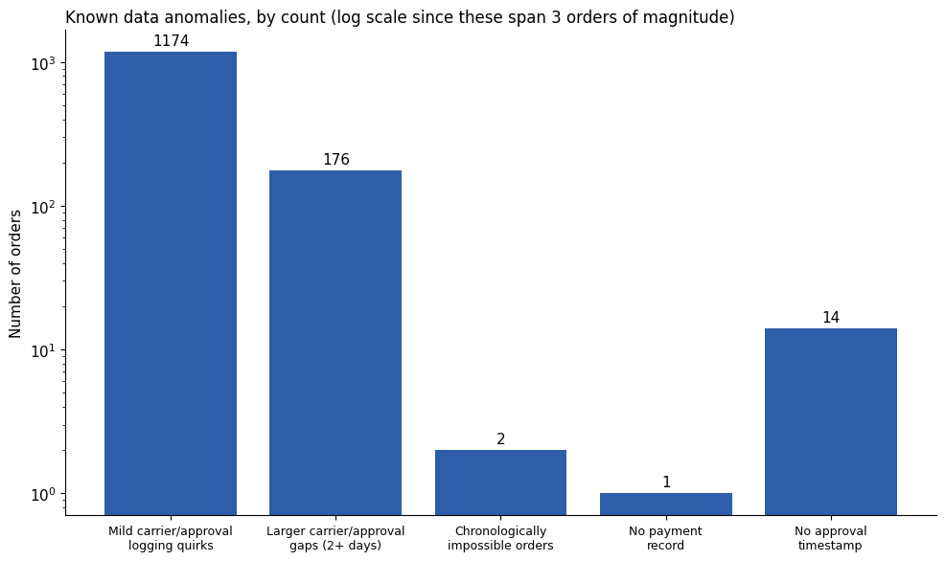
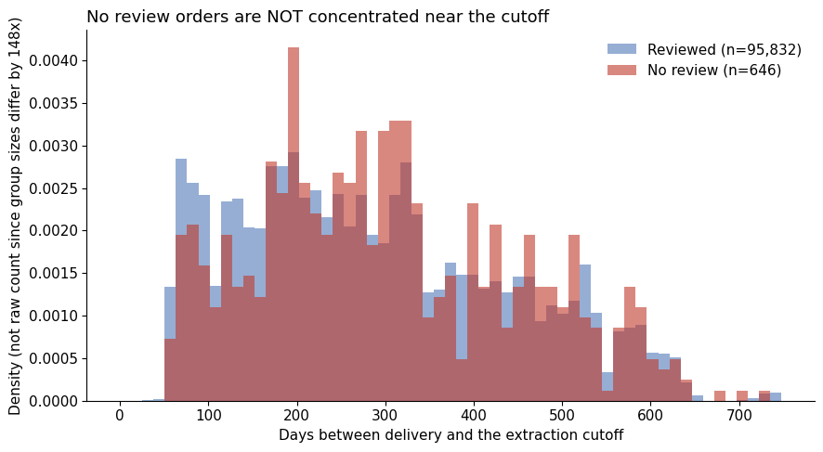
Some gaps in the data
A gap in reviews:
646 delivered orders have no review which is a real gap that could either be extraction limitation or non response
But since orders with no reviews are NOT concentrated near the dataset's extraction cutoff, it is genuinely non response from customers
Data anomalies that were found:
2 chronologically impossible orders
1 missing payment record
1174 logging mismatches of timestamps

Slide 5
Feature Engineering & Derived Metrics
delivery_delay_days has been divided into 5 different delay buckets, starting from 5+ days early to 8+ days late
processing_days (seller dependent) vs. transport_days (carrier dependent) is giving more insights into the actual reason of the delay which is very useful in explaining the project's central finding
freight_ratio = freight cost / item price, has been calculated as a size independent way to compare shipping burden
seller_low_confidence flag (fewer than 5 orders) has been applied and carried through every seller level chart in this project
is_repeat customer flag has been implemented to check the customers coming back
primary_category (highest priced item in a multi item order) has also been applied to aggregate orders and keep each one tied to one category

Slide 6
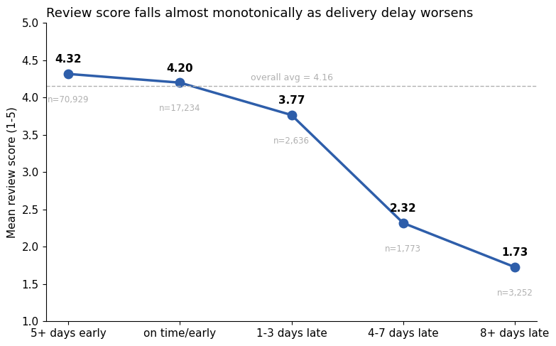
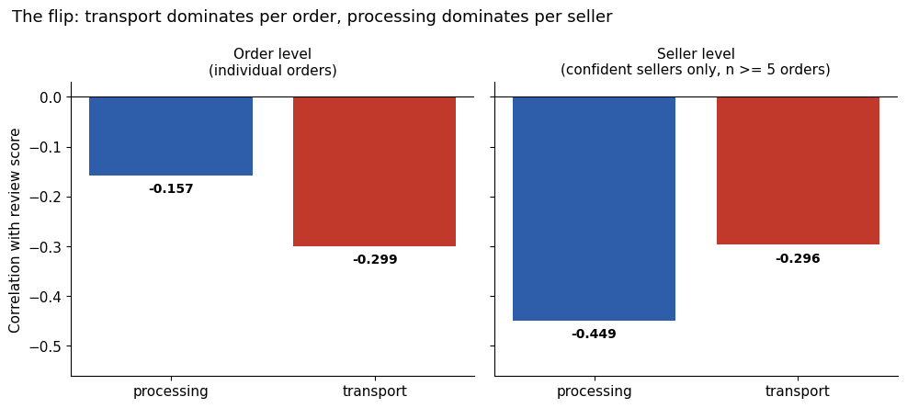
Delivery Performance
Finding: Review score declines almost monotonically as the delay gets worse
From 4.32 for orders arriving 5+ days early to 1.73 for orders which are 8+ days late, there is 2.6 points collapse on a 5 point scale.
Finding: Delay predicts the satisfaction but looking at it by further dividing it,
Transport time (carrier side) affects more at an individual order level
Whereas processing time (seller side) shows which sellers are actually reliable

Slide 7
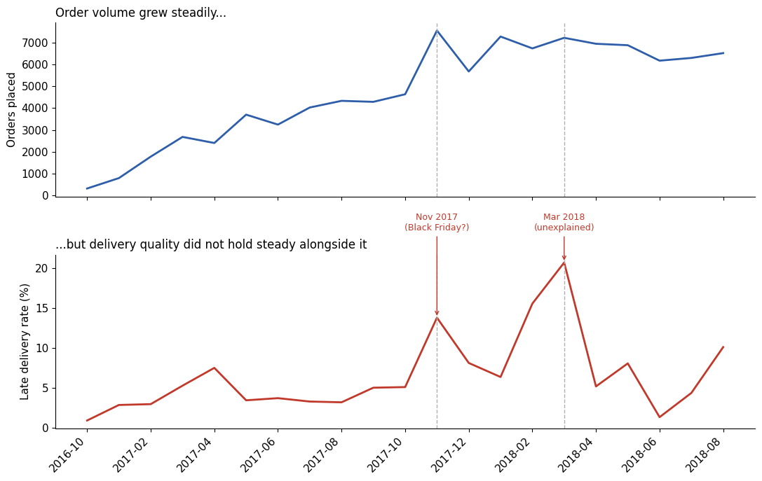
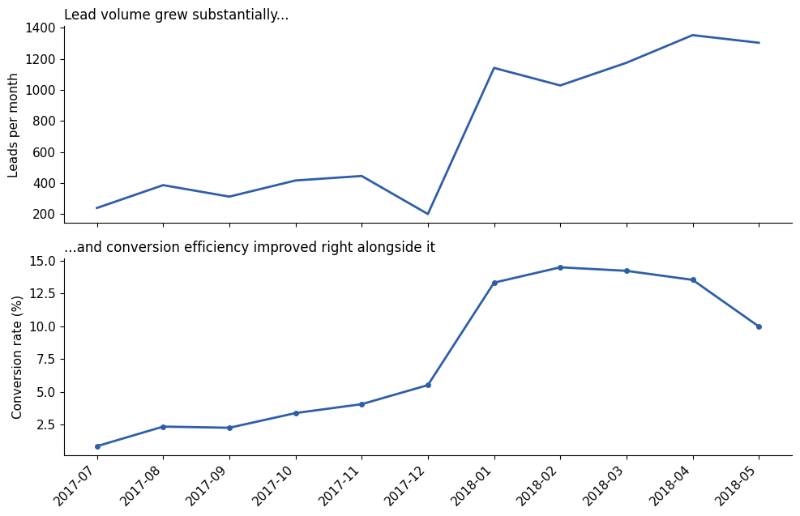
Growth vs Quality
Finding: Order volume has grown mostly steadily across the months but late delivery rate has two major spikes
November 2017 has 13.8% late rate compared to 5% in surrounding months, possibly due to Black Friday demands
March 2018 has a bigger spike with the most late rate of 20.7% without any concrete explanation
Finding: Monthly conversion rate increased from 1% to 14% even as lead volume grew from a few hundreds to over 1300 per month
This is opposite from the pattern on the left, which means acquisition got more efficient with scale while delivery operations didn’t stay uniform.
These two charts shows that pressure of growth did not impact every part of the business the same way and hence it’s the strongest proof for growth vs quality

Slide 8
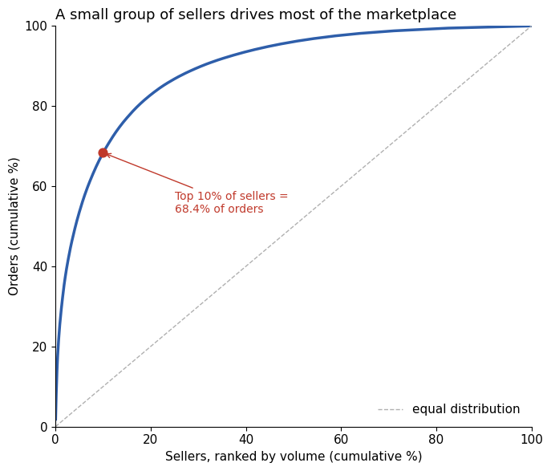
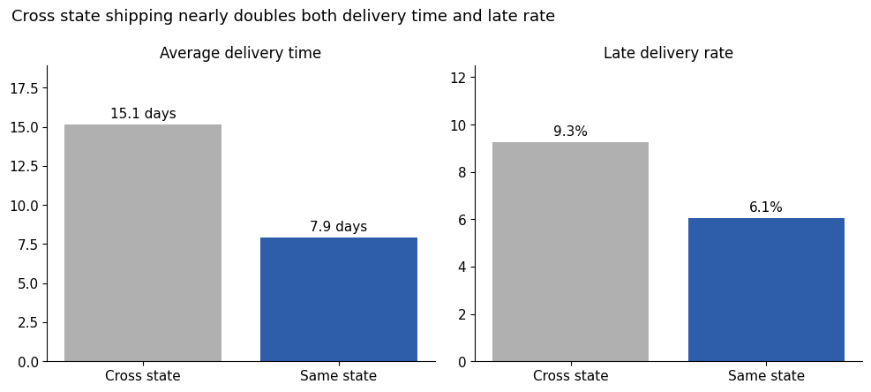
Geography & Sellers: Where Risk Concentrates
Finding: Cross state shipping nearly doubles both delivery time and late rate
Deliveries take almost twice as long (15.1 vs 7.9 days)
And they are also more likely to be late (9.3% vs 6.1%)
This is an expected direction since distance takes time, and this confirms that it is there in this dataset as well.
Finding: The top 10% sellers by volume account for 68% orders which is very far from an even spread
A strong indicator to support high volume sellers with better tools and priority carrier management rather than going with broad uniform policies for all the sellers.

Slide 9
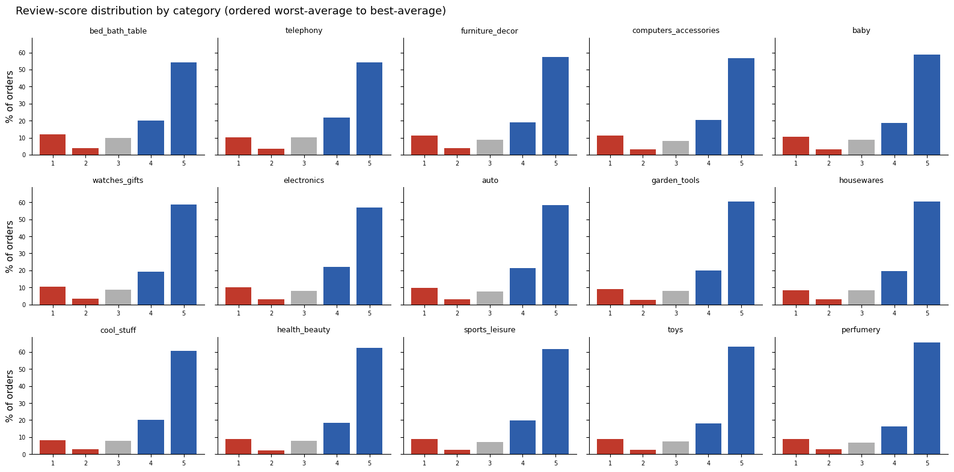
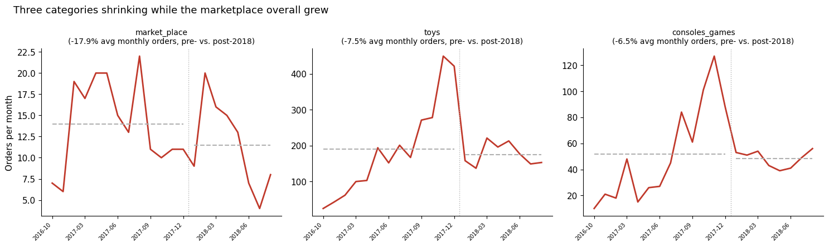
Category & Economics
Finding: Every category has the same bimodal shape with taller 5 star bar and smaller 1 star bar and very thin middle
It shows that the categories doesn’t really change how people rate.
Which tells us that categories themselves have a smaller contribution to the driving factor of the ratings.
Finding: These three categories are shrinking even when the marketplace has grown overall
All three show a visibly lower average after 2018 boundary than before it.
This is not about delivery quality or cancellations but about the demand shrinking in these specific categories even with the marketplace as whole growing.
So the demand or growth is not reaching here rather than a satisfaction risk.

Slide 10
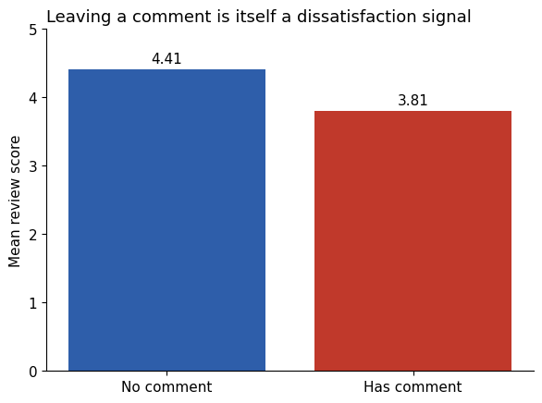
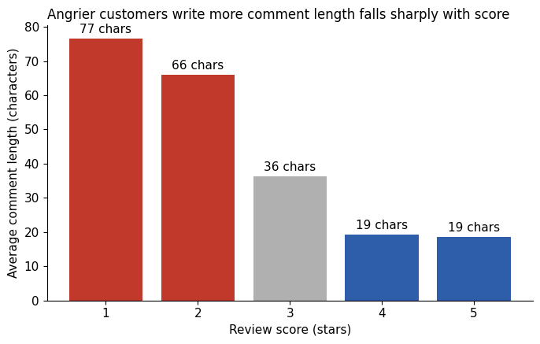
Customer Behavior
Finding: Order reviews with comment has an average review score 3.81 whereas the ones having no comments on average has 4.41
This shows a strong dissatisfaction rate for the orders having a comment even without knowing what they have actually written.
Finding: 1 star comments has 77 characters on average which is 4 times more than 19 characters of 5 star comments and the relationship is cleanly monotonic for all five scores.
So it’s not just whether a customer leaves a comment but how much they write directly scales with more dissatisfaction.

Slide 11
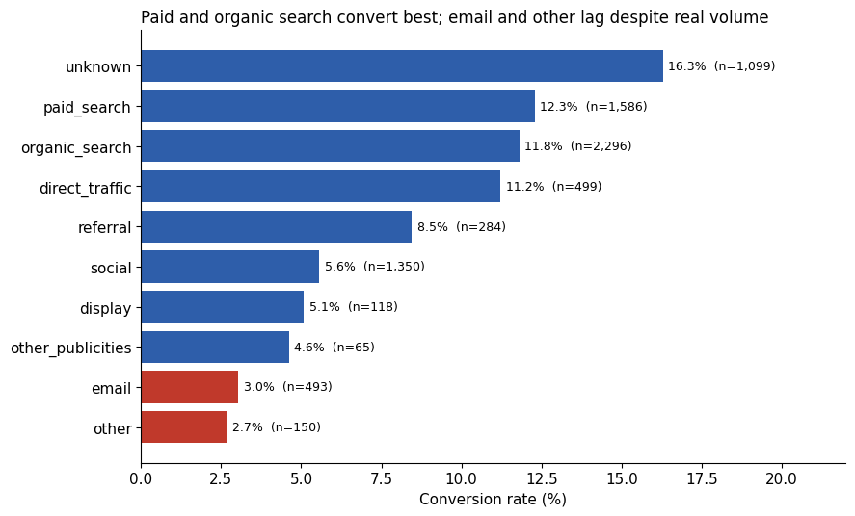
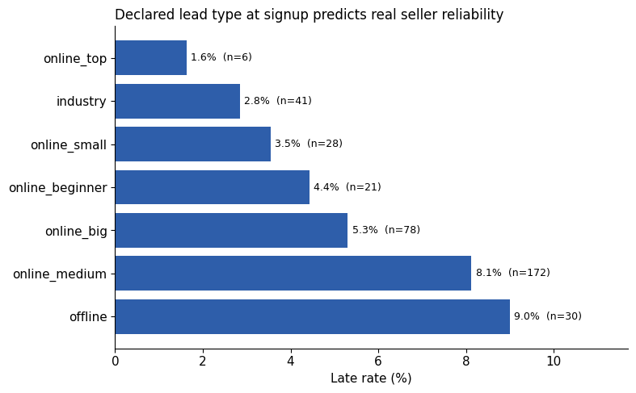
Acquisition Funnel
Finding: Overall conversion rate is around 10% but the origin of the lead matters.
Paid search and Organic search convert above average while email and other are performing worst despite a reasonable lead volume
High rate for unknown is worth checking since it shows a tracking gap for the highest conversion rate of any origin
Finding: The business type of a lead has a fairly clear gradient showing the seller reliability
Online top has the lowest % but only 6 sellers so it is too small to rely on heavily
But industry with 2.8% is outperforming online medium and offline which are 8 to 9 %, with reasonable sellers

Slide 12
Dashboard Walkthrough
Overview:
The interactive dashboard has been built using Streamlit, including all the charts displayed here and some other interesting charts in each category.
The dashboard has total six pages including the home page for the overview and central findings along with five other pages for each of the categories.
It has five filters as well: product category, customer state, seller state, seller size, and delivery performance.
Every metric (like rate or average) shown displays its sample size and segments below a safe threshold are explicitly flagged rather than shown with false confidence.
You can hover over any metric or a chart component to see what they represent along with the actual number.
The reset filters clears all the filters applied and shows the original charts once again.

Slide 13
Some interesting findings
No holiday tolerance effect, in fact customers are slightly less forgiving of delay in Nov 17 - Jan 18.
An early delivery ceiling effect, as satisfaction peaks at 15 to 21 days early, then goes down again.
Some categories (toys/health/sports) punish delay harder than others (furniture/housewares) which likely shows that planned or expensive orders are okay with delay somewhat more than the ones bought on impulse or the ones that require a quick delivery. For example toys for birthday presents or some health or sports gear that one needs urgently.
Loyal customer shows patience for big delays, not small slips since the repeat customers score worse at 1 to 3 days late, but better at 8+ days late.
Only 6.3% of customers ever place a second order, with most of the returning customers stopping at 2 orders.
An unlabeled internal tag (lead_behaviour_profile) correlates with real outcomes although how it works or what it means is unknown from the given dataset.
A small number of sales representatives have closed a large number of deals with the top one closing 122 deals among the total of 842 converted leads.
Note : Some of these carry smaller samples and more speculative mechanisms which are presented with their caveats intact, not as solid final conclusions.

Slide 14
Recommendations
Where to Invest:
The logistics and carrier network has the most improvement scope since the delivery delay has been the strongest factor in impacting the customer reviews. The deliveries which are being late within the same state can be improved first and then some of the routes or cross states deliveries with a large delays can be fixed with better delivery partners as well.
Since the top 10% of sellers seems to be driving almost 70% of orders, there can be a priority support and better tools or infrastructure for these sellers so they can minimize the late rate and receive more positive reviews.
Where to Intervene:
To check the reliability of sellers, use processing time instead of overall late rate of the seller since how much time the seller takes to process an order before handing it off to carriers, matters more and it reveals how fast does a seller work.
Prioritize delivery for the categories that are punishing the delay more, since the timely delivery for the urgently required products matters the most than heavier purchase like furnitures or home decor.
What to Monitor:
Check the business type of a seller when they are signing up to get a rough idea of their projected performance based on the already available data of existing sellers and their business type.
Investigate the lowest performing month in all the datasets which is March 2018. Find out what went wrong, was there any seasonal factors that affected the month or a genuine operations problem with the company.

Slide 15
Limitations & Open Questions
March 2018's late delivery spike is real and cross validated but its cause is unknown from this data alone, need some more insights into what happened to derive any meaningful conclusions or an action plan to work on the fixes.
The funnel data covers only 12% of active sellers so the findings related to this section and data only apply to that overlap, and not all the sellers. More data needs to be collected to identify more concrete patterns for the sellers behaviour and performance.
Some of the interesting findings are directional, not definitive since the samples are smaller and its based on the speculation of what could have been the case, so again need more data to prove them further.
Review comment text has a lot of null values and the ones having a review have not been translated or looked into each of them individually.
Future scope:
External event data for March 2018
Detailed funnel data, starting from the landing page itself
Richer product description analysis and a product level exploration with more data

Slide 16
Thank You
Questions?

